Slide 1
Types and Variables

Slide 2

Variables
Storage for various things
Each variables has a type. The type specifies:
Size and layout of the memory the variable takes
Range of values that can be stored within that memory
What operations can be applied to the variable

Slide 3
Integral Types
Type | Bytes | Other Names | Range of values (Decimal)
signed char | 1 | char | -128 to 127
unsigned char | 1 | char | 0 to 255
signed short int | 2 | short, short int, signed short | -32,768 to 32,767
unsigned short int | 2 | unsigned short | 0 to 65,535
signed int | 2 in 32-bit, 4 in 64-bit | int, signed | -2,147,483,648 to 2,147,483,647
unsigned int | 2 in 32-bit, 4 in 64-bit | unsigned | 0 to 4,294,967,295
signed long int | 4 in 32-bit, 8 in 64-bit | long, long int, signed long | -9,223,372,036,854,775, 808 to 9,223,372,036,854,775,807
unsigned long int | 4 in 32-bit, 8 in 64-bit | unsigned long | 0 to 18,446,744,073,709,551,615

Slide 4
Floating Point Types
Type | Bytes | Range
float | 4 | 1e-37 to 1e37
double | 4 in 32-bit, 8 in 64-bit | 1e-308 to 1e308

Slide 5
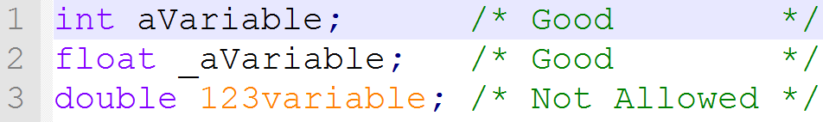
Identifiers
Identifiers are the names for variables, function, etc.
They are case sensitive, so variable, VARIABLE, vARIABLE, and Variable would all be different
These can include:
Letters
Numbers
Underscores
But they must begin with either a letter or an underscore

Slide 6
Keywords
Special words that C uses that can’t be used for identifiers
They are case-sensitive and will only work if all lower case (int is not the same as Int or INT)
“auto” is deprecated in C and should not be used
auto | const | double | float | int | short | struct | unsigned
break | continue | else | for | long | signed | switch | void
case | default | enum | goto | register | sizeof | typedef | volatile
char | do | extern | if | return | static | union | while

Slide 7
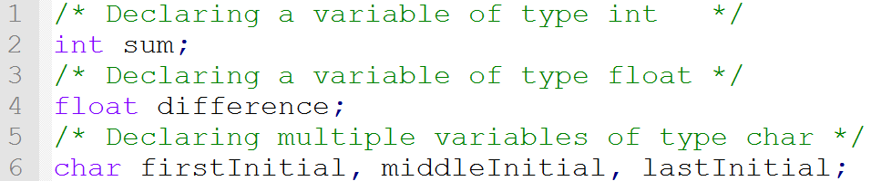
Declarations
Declaration provides basic attributes: a type and name
Variables must be declared first, at the top of a function
Contains garbage (random values) when initially declared

Slide 8
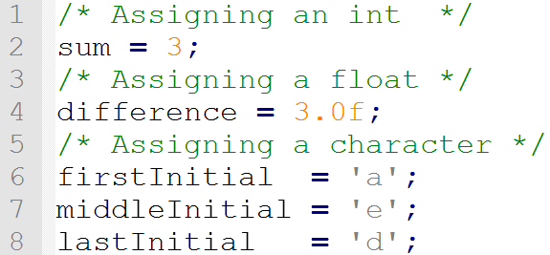
Assignment
Can assign (store) a value to a variable using the assignment operator (the = symbol)

Slide 9
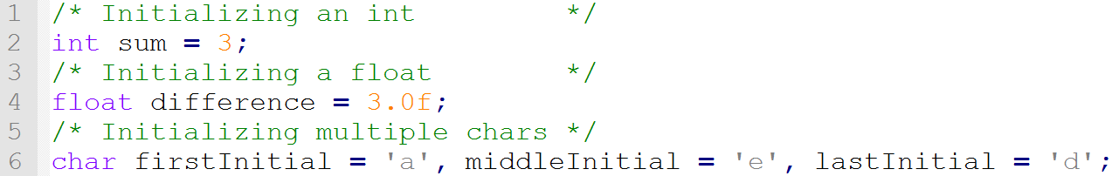
Initializing
Declaring and assigning, all in one neat line!

Slide 10
Summary
Different types take up different memory and can hold different values
Identifiers are case-sensitive names; they can only include letters, numbers, and underscores
Certain keywords in C that can’t be used for identifiers
Declaring provides the basic attributes: a type and a name
Assigning gives the variable a value
Initializing is declaring and assigning in one step

Slide 11
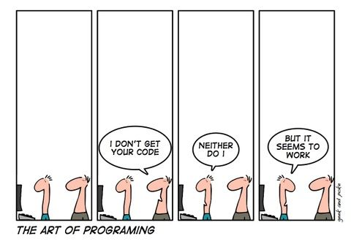
Questions?

